Slide 1


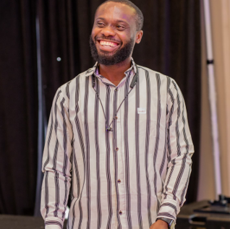

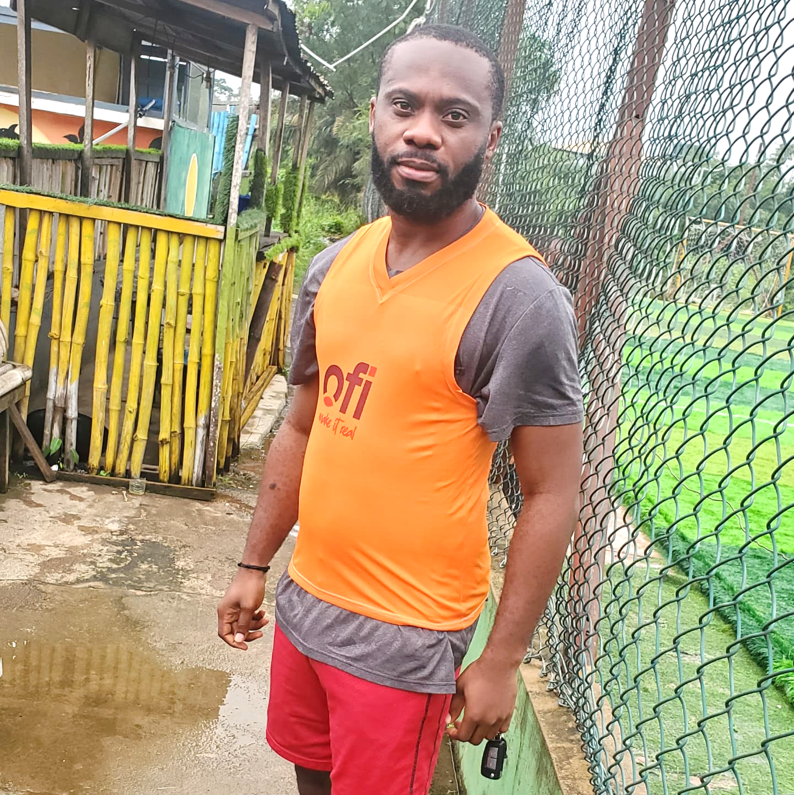
Getting to Know Me
Work
Personal
My role
EUDR Compliance Lead
Significant others / family members / furry friends in my life
My lovely wife, my ever-caring Mom and my wonderful kids
Tenure in ofi/Olam
2 Years
How I enjoy spending my free time
Read books, play football or go admire nature
Previous companies I have worked at
Opay
My favorite / comfort food
When I'm happy I love Rice and chicken, When I'm starving, all foods are my favorite
Chuks Mbata
‘what name you prefer to be called’
Just call me Chuks. Not Chucks
Why I joined ofi/Olam and what keeps me here?
Aligns with my career dreams
My favorite song
Spiritual Healing by 2face Idibia
A few fun facts about me
First thing I do every morning is to smile so brightly
This is me outside work, doing stuff I enjoy in my life …

